Slide 1
Capstone Project
Bike Sharing Demand Prediction

Slide 2
Content
Problem Statement
Data Summary
Data Analysis
Challenges
Conclusions
Q&A

Slide 3
Problem Statement
Currently Rental bikes are introduced in many urban cities for the enhancement of mobility comfort. It is important to make the rental bike available and accessible to the public at the right time as it lessens the waiting time. Eventually, providing the city with a stable supply of rental bikes becomes a major concern. The crucial part is the prediction of bike count required at each hour for the stable supply of rental bikes.

Slide 4
Data Summary
Date : year-month-day
Rented Bike count - Count of bikes rented at each hour
Hour - Hour of the day
Temperature-Temperature in Celsius
Humidity - relative humidity in percentage
Windspeed - wind speed in m/s
Visibility - 10m
Dew point temperature - Celsius
Solar radiation - MJ/m2
Rainfall - mm
Snowfall - cm
Seasons - Winter, Spring, Summer, Autumn
Holiday - Holiday/No holiday
Functional Day - NoFunc(Non Functional Hours), Fun(Functional hours)

Slide 5
Basic Exploration
Dataset contains 8760 rows & 14 columns
Five categorical features ‘Date’ , ‘Hour’ , ‘Seasons’ , ‘Holiday’ & ‘Functioning Day’
Nine continuous feature ‘Rented Bike Count’ , ‘Temperature’ , ‘Humidity’ , ‘Wind speed’ , ‘Visibility’ , ‘Dew point temperature’ , ‘Solar Radiation’ , ‘Rainfall’ & ‘Snowfall’
Rented Bike Count is dependent variable
No null values present in dataset

Slide 6
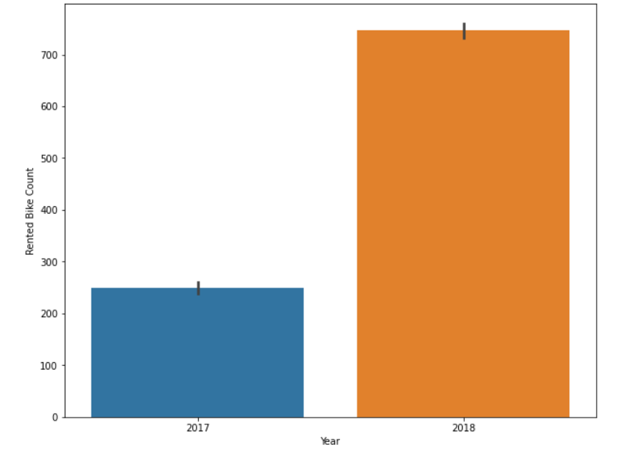
Rented Bike Count per Year

Slide 7
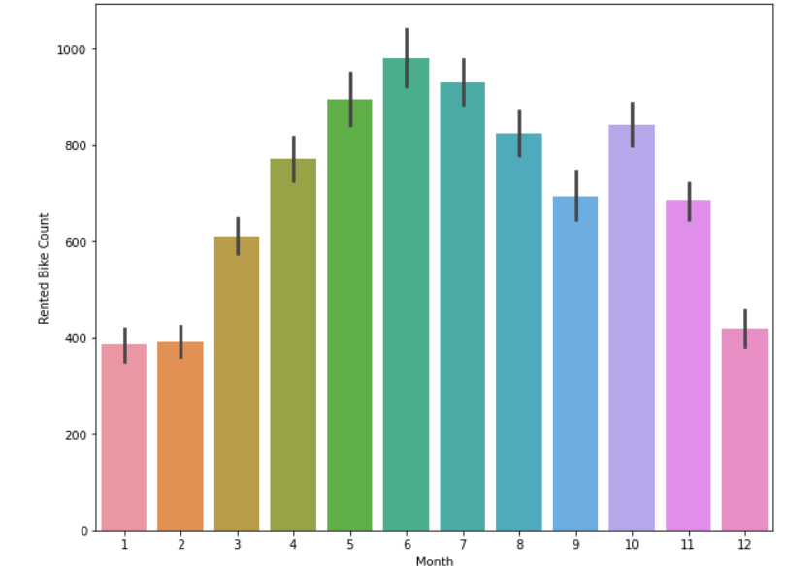
Rented Bike Count per Month

Slide 8
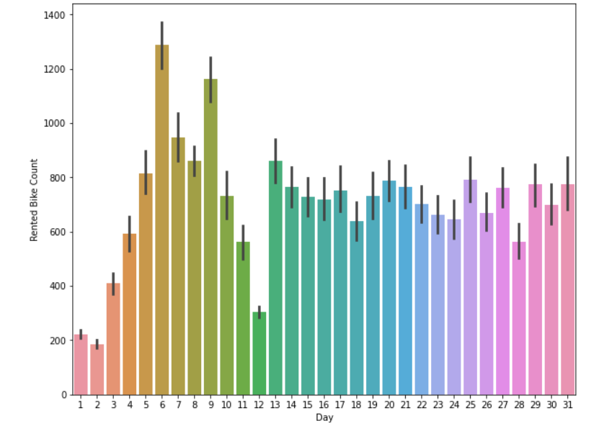
Rented Bike Count per Day

Slide 9
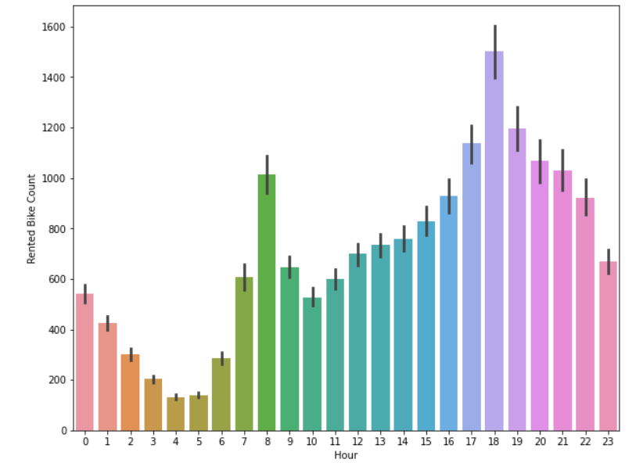
Rented Bike Count per Hour

Slide 10
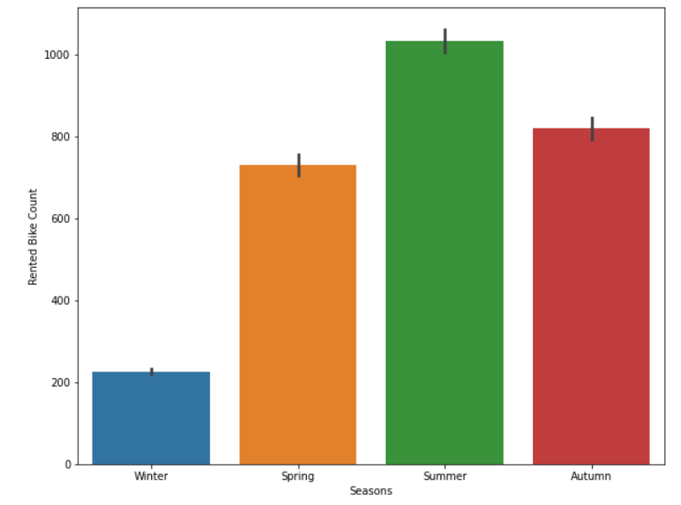
Rented Bike Count per Seasons

Slide 11
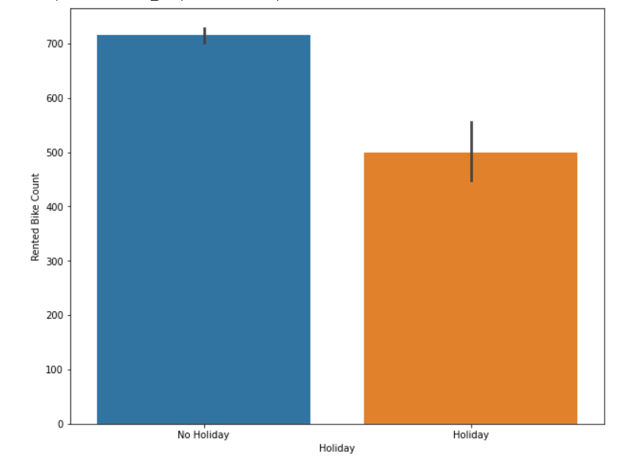
Rented Bike Count per Holiday

Slide 12
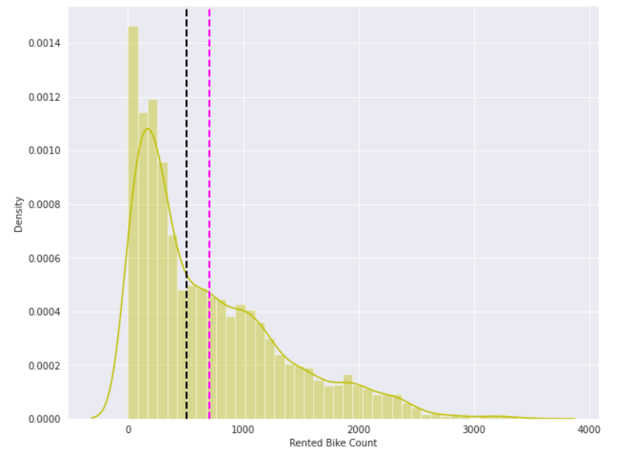
Distribution plot of Rented Bike Count

Slide 13
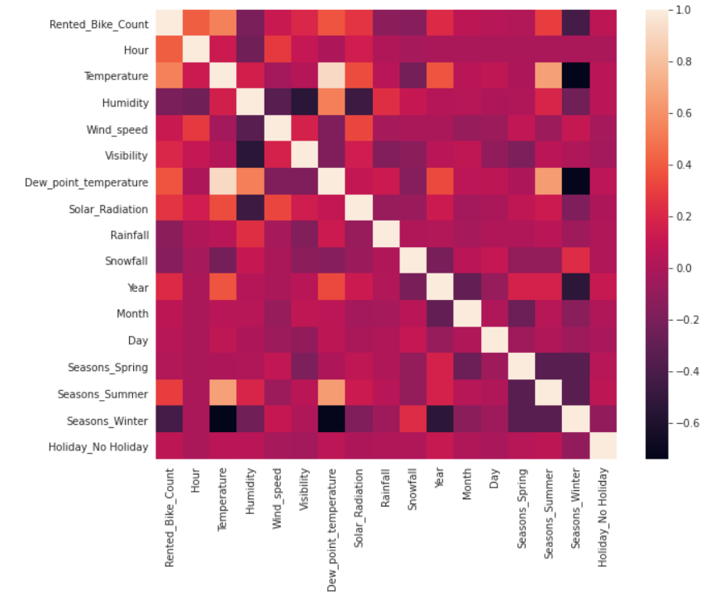
Correlation

Slide 14
Polynomial Regression
Linear Regression
Train Set Metrics Test Set Metrics
R2 | 0.50
Adjusted R2 | 0.50
R2 | 0.49
Adjusted R2 | 0.49
Train Set Metrics Test Set Metrics
R2 | 0.65
Adjusted R2 | 0.64
R2 | 0.62
Adjusted R2 | 0.62

Slide 15
Lasso Regression
Ridge Regression
Train Set Metrics Test Set Metrics
R2 | 0.50
Adjusted R2 | 0.50
R2 | 0.49
Adjusted R2 | 0.49
Train Set Metrics Test Set Metrics
R2 | 0.50
Adjusted R2 | 0.50
R2 | 0.49
Adjusted R2 | 0.49

Slide 16
XGboost Algorithm
Random Forest Regressor Algorithm
Train Set Metrics Test Set Metrics
R2 | 0.97
Adjusted R2 | 0.97
R2 | 0.81
Adjusted R2 | 0.81
Train Set Metrics Test Set Metrics
R2 | 0.99
Adjusted R2 | 0.99
R2 | 0.96
Adjusted R2 | 0.96

Slide 17
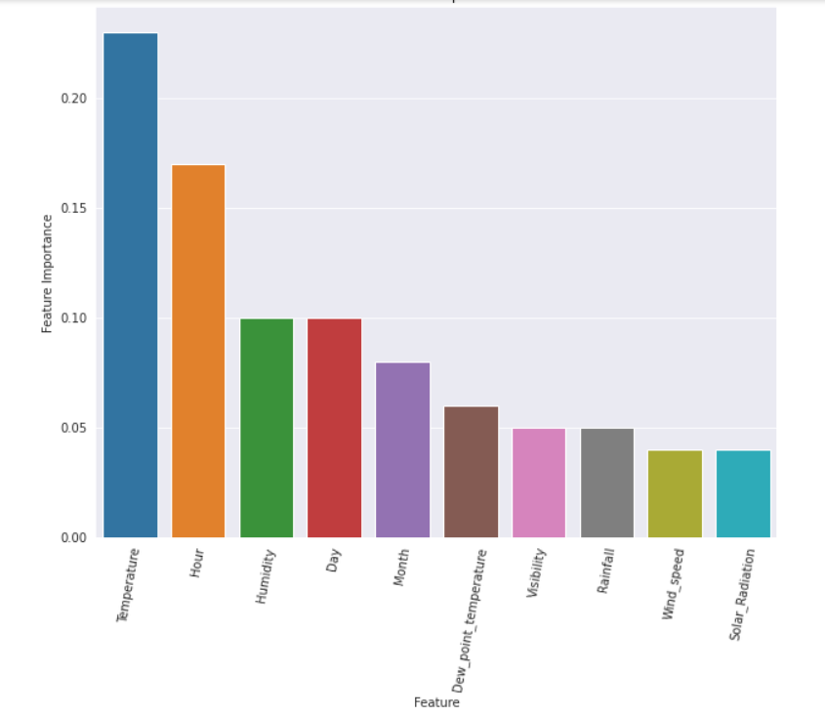
Random Forest Regressor Feature Importance

Slide 18
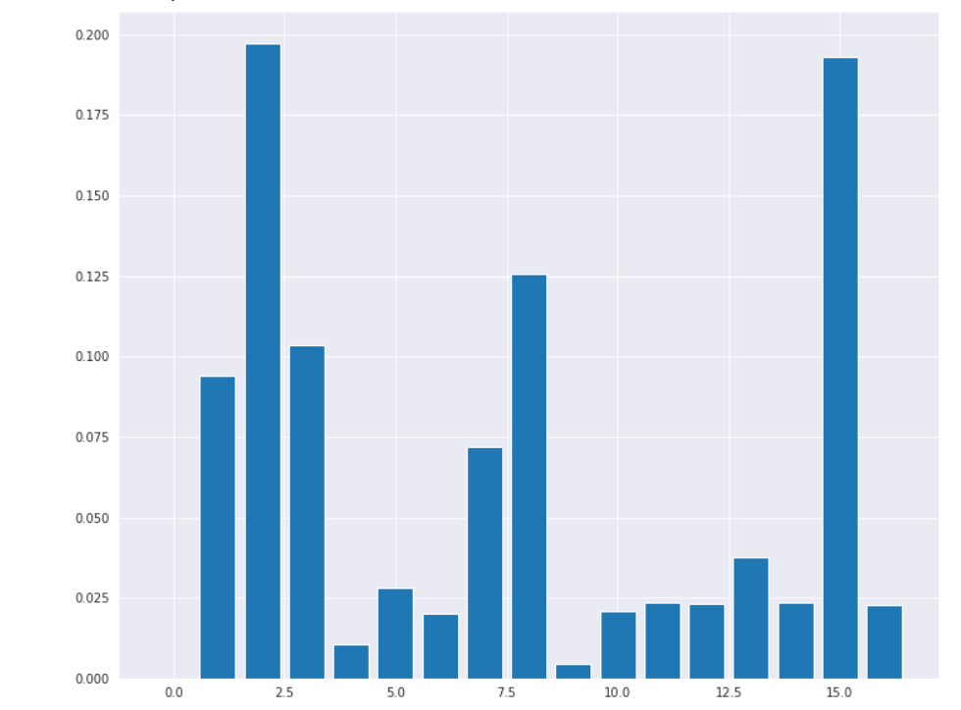
XGboost Algorithm Feature Importance

Slide 19
Challenges
Feature Engineering
Optimising the Model

Slide 20
Conclusion
There is an high demand for Rented Bikes in the year 2018 .
There is an high demand for Rented Bikes in the month of May, June and July .
There is an high demand for Rented Bikes in the day 6 , 7 and 9 .
There is an high demand for Rented Bikes in the hour 17 , 18 and 19 .
Summer season has highest Demand for Rented bikes and Winter has least Demand.
No Holiday has higher Demand compare to Holiday .
The features hour & temperature are the features that influence the most of the bike sharing demand data
Comparing to all algorithms XGboost algorithm has less Mean Squared error and Mean absolute error,and gives a model score upto 99% and R-Squared value is 96%, so it is concluded as optimal model.

Slide 21
Q & A

Slide 22
Thank You

